Slide 1

Bias in Hollywood: Biopics Data
By: Aria Fisher

Slide 2
Intro
The dataset examined in this presentation contained information about assorted biopics, spanning from as far back as 1915 to 2014, before cleaning it had 762 rows
The data was sourced from GitHub and analyzed with SAS
Variables:
Title, IMDb link, Country, Year of release, Box office, Type of subject, Subject race, Person of Color (binary value), and more.
I chose to examine this data because biopics have been coming back into the film industry, and as a result there has been critical analysis of the genre.
Portrayal of women, historical accuracy, diversity and inclusion

Slide 3
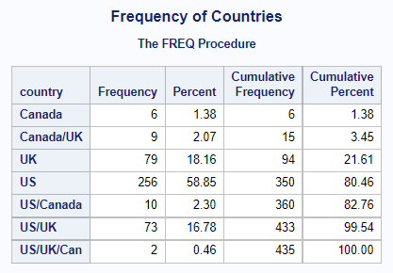
Major Results
Began with an analysis of country of origin.
Majority originated from the US alone- 58.85%
All originated from some combination of the US, UK, or Canada
Can draw general conclusions about Hollywood and the US film industry.

Slide 4
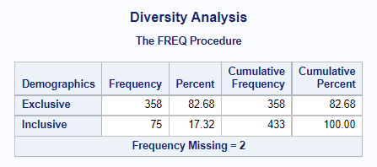
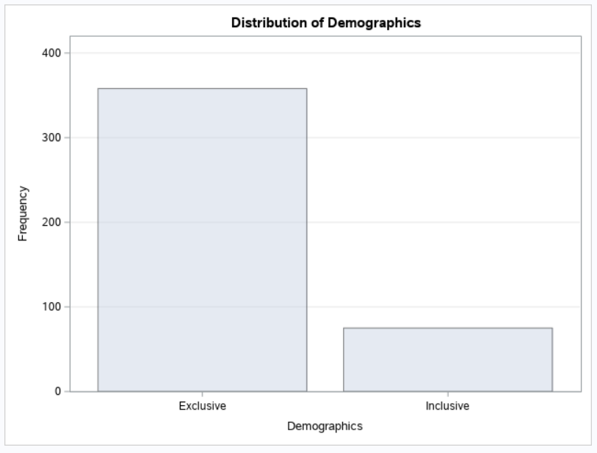
Major Results pt.2
Continued into analysis of inclusion
Using the binary person of color variable, found the frequency of movies in the dataset whose lead actor was a person of color.
Graphic representation demonstrated how large the gap truly is.
82.68% exclusive, or 358 biopics
17.32% inclusive, or 75 biopics

Slide 5
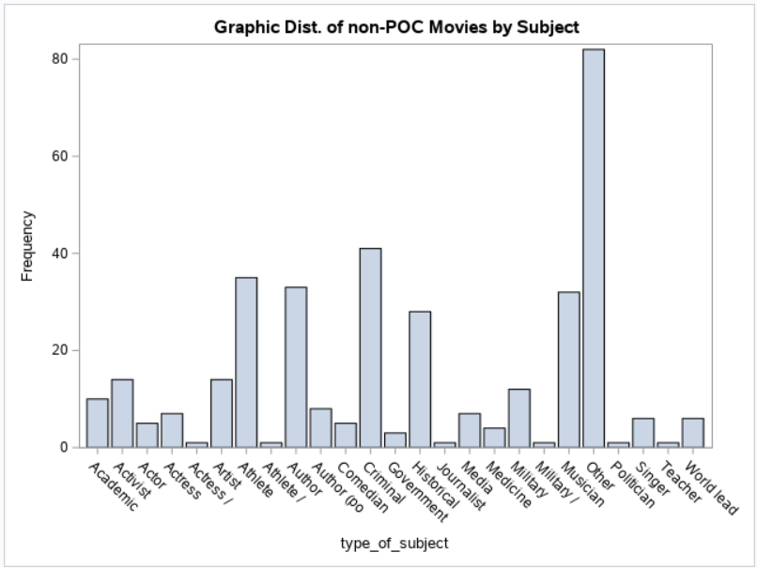
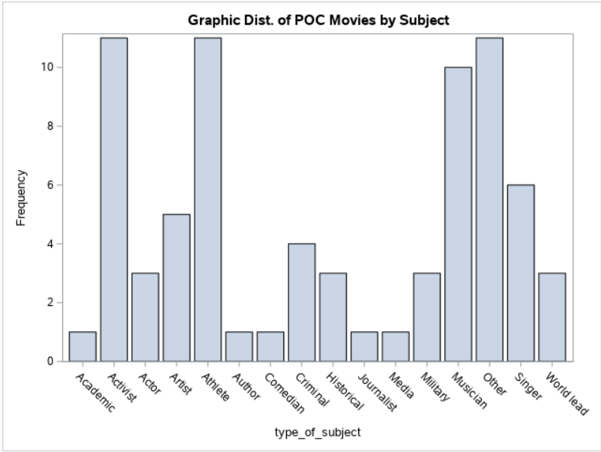

Slide 6
Major Results pt.3
Using the inclusive/exclusive categorizations, I executed a frequency analysis of the Type of Subject variable.
The README on GitHub describes Type of Subject as the occupation of the biopic’s subject or “reason for recognition”
Breadth of subject matter is vastly limited for inclusive movies vs. non-inclusive movies
16 vs. 25
Both have a high frequency of movies categorized as other, but the close similarities lessen after that.
Athlete- popular in both, but 14.67% for inclusive and 9.78% for exclusive
Musician- 13.33% compared to 8.94%
Activist- 14.67% compared to 3.91%

Slide 7
Conclusion
Most biopics in this set originated in the US- either solely or by way of combination.
There is a clear disparity in the representation of white people compared to the representation of people of color.
Gap of about 65 percentage points
Biopics specifically carry social significance-
“You can’t separate obviously the production of biopics from the larger culture of society and the industry itself…Often biopics are about ‘important people’ and I think the farther back you go the more ‘great [white] men’ you see”
The differences in subject matter represented and even the differences in breadth of subject could indicate a larger perception of POC in Hollywood and general culture.
Account for the fact that there were simply less inclusive movies, but the difference remains.
14.67% activist vs. 3.91% activist
What stories and people are seen as important enough to be represented in film, and what does that say about the communities they represent?

Slide 8
Works Cited
Fingerhut, Hannah. “'Straight Outta Compton' Is the Rare Biopic Not About White Dudes.” FiveThirtyEight, FiveThirtyEight, 14 Aug. 2015, https://fivethirtyeight.com/features/straight-outta-compton-is-the-rare-biopic-not-about-white-dudes/.
data/biopics at master · fivethirtyeight/data · GitHub

